Slide 1
CS598: Human-in-the-loop Data Management

Slide 2
Today’s class
The essentials
Bird’s eye view of the class material
Getting to know you

Slide 3
The Essentials
Instructor: Aditya Parameswaran
Office: 2114SC
Email: adityagp@illinois.edu.
Mention “CS598” in email title
I get a LOT of email – do so if you want a response!
Meeting Slots:
M/W 9.30-10.45 at 1103SC
Office Hours:
M 10.45-11.30 (or on demand)

Slide 4
The Essentials
TA: Tarique Siddiqui
Email: tsiddiq2@illinois.edu
Mention “CS598” in email title
OH: Fri 9-10AM
Website:
http://cs598.github.io

Slide 5
The Essentials
Prerequisites:
Basic algorithms and probability
A database course of some form
At a high level, you should be familiar with topics such as (or be willing to pick them up)
Relational algebra and SQL
Semi-structured data
Query processing and optimization
Data warehousing and data cubes
I am happy to have people from different backgrounds…
But talk to me if you’re not sure
MCS or MS/PhD in a different field – talk to me.

Slide 6
What sort of a course is this?
This is a research-oriented course
Very much a “take what you want”
You will not be tested (exams, assignments) or taught (lectures) traditionally: not my job!
Instead, you will engage in research
Read, comment on, and discuss papers
I won’t be teaching: we will discuss together
Pursue a research project
That said: this is not an easy course!
The research project requires dedication and ingenuity + dealing with unpredictable outcomes
If you haven’t done research at all before, talk to me!

Slide 7
Course Objectives
Learning advanced database topics
Focusing on an important sub-area:
Data processing and management OF/FOR/BY humans
i.e., emphasizing the human element
Especially important in the age of “data science”
Learn how to critically evaluate papers
Present research
Do novel, ~publishable research

Slide 8
Grading
Class Reviews: 20%
due day before class at midnight. Starts on 13th Sep
Class Participation: 15%
Paper Presentation: 15%
Send us top 5 papers you’d like to present tonight
Research Project: 50%
Proposal (25th Sep) + report + presentation
I will grade on an absolute scale rather than on a curve.
All of you could get A’s!
Emphasis is on learning collectively than *test* you
If your project is truly amazing, you get an automatic A

Slide 9
Class Reviews
Since there are no textbooks or exams, I need to be convinced that you’re learning.
By Sunday/Tuesday at midnight, submit a review of the paper to be discussed on Monday/Wednesday.
Review (up to 500 words – shorter is fine)
What is it about? Why is it significant?
Key technical contributions relative to previous work
Key limitations of technique(s) or unsolved issues
Key discussion questions for class
First time you will do this: Tuesday Sept 12.
We will send out instructions by tonight.

Slide 10
Class Reviews: Grading
20% of your grade
“Lightly graded”: we will check if you’ve indeed read the paper and identified something not superficial
Not a heavy emphasis on testing
We will let you skip 3 of the papers covered
You decide which ones: no penalty
Every additional paper you miss beyond the 3 results in an automatic 1/20 drop
Want to make sure you’re reading for active discussion
We may allow you to make this up by presenting …
No late submissions accepted!

Slide 11
Class Participation
15% of your grade
Classes will be divided into two parts, sometimes interspersed
Paper presentation (driven by a student/me)
Discussion (driven by me)
For the discussion part, I will initiate an open-ended debate on the paper
What could the authors have done better?
What they did they do well?
(be prepared with your questions about the paper)
Participating in the discussion is essential!

Slide 12
Paper Presentation
15% of your grade
Decide by tonight midnight which papers you’d be interested in presenting
Any paper from the reading list (preferably) or others in space
Link up on website
Also send us any constraints as to days you cannot present (be reasonable!)

Slide 13
Paper Presentation
30-40 minute presentation should have 30ish slides
Before preparing, understand paper + background; may need to read related papers!
Cover all “key” aspects of paper
What is the paper about? Give necessary background
Why is it important? Why is it different from prior work?
Explain key technical ideas; show how they work
As few formulae and definitions as possible! Use examples & intuition instead!
The presentation slides should be mailed to Tarique 48 hrs prior to your presentation

Slide 14
Paper Presentation: Caveats
Depending on how registration goes…
We may double up some of you with shorter presentations (15-20 minutes as opposed to 30-40)
We’ll keep you posted

Slide 15
Research/Implementation Project
50% of your grade
Build/design/test something new and cool!
Should be “original”, e.g., reimplementing
an algorithm from a paper
a tool that already exists
is not sufficient
The goal: having something publishable-ish at a Database/Data Mining/Systems conference
Amaze us (of course, we will help)

Slide 16
Research/Implementation Project: Requirements
Spectrum of contributions: Contribution can be
Mainly algorithmic,
with a simple prototype
Mainly the tool or a component of a tool,
with simple algorithms
A mixture of both
So, even if you design an algorithm, you need to implement + get your hands dirty
This is typically required at database conferences

Slide 17
Research/Implementation Project: Requirements
If your main contribution is a tool/component:
The emphasis is not the UI, and instead the data analytics task
Demonstrate: novelty, scalability/efficiency, usability
If your main contribution is an algorithm:
For a well-studied task or a new task
Demonstrate: novelty, proof of correctness + scalability/efficiency

Slide 18
Research/Implementation Project: Requirements
Phases:
Week 3: Identify problem
Consult us when you’re picking this – we can help!
Week 6: Explore related work/related tools
We need to be convinced that this is new
Learn how to position relative to state-of-the-art
Starting digging into tools (if they exist)
Week 9: Prototype techniques and algorithms
Week 12: Build tool/Implement/Test
Week 14: Write “paper”

Slide 19
Research/Implementation Project: Spectrum of Options
This could be:
A tool to automatically detects data errors or violations
A scatter-plot tool that scales to 10M datapoints
A new approximate query processing system based on operating on models instead of data
A new algorithm for human-supervised categorization
Extending an existing algorithm to handle a new setting or domain
<insert your domain specific tool, especially encouraged!>

Slide 20
Research/Implementation Project
We are happy to provide suggestions…
But ideally we would like you to pick projects that you are already working on that could use techniques from this class, or problems that you’re passionate about.
The most successful projects from this class have led to HCOMP, KDD, and VLDB papers!
If you’d like, we can partner you up with a PhD student from our group…

Slide 21
Research/Implementation Project
Implement a novel component of Zenvisage, our effortless visualization tool
Code up a parser/optimizer for a versioning query language in our versioning tool, Orpheus
Adapt our declarative machine learning tool, Gestalt, to allow for automatic feature selection
Build a merging tool that allows users to merge two datasets into one by showcasing differences
Analyze a large dataset of tasks from a crowdsourcing marketplace to provide task recommendations / search
Design a perspective-aware crowdsourced clustering scheme
Notes:
Potential small research projects using the CF dataset:1) Workers evolving through time2) Task search engine (used for "similar task" / template recommendations)3) More generalized query engine --- for example input type of task, output stats, recommendations, examples4) Refining analyses in paper for extended journal submission5) More detailed marketplace analyses: look at _supply-demand interactions <--> latency / throughput interactions

Slide 22
Research/Implementation Projects
Project team sizes
1 or 2
If you go with 2, then we need to be convinced that you did ~twice as much work
You’ll meet us at three points
By week 3: deciding the project (PROPOSAL)
By week 8: presenting the preliminary outline of how the project will shape up (PRELIMINARY)
By week 14: final project report and presentation to class (FINAL REPORT)

Slide 23
Questions about the Class Essentials?

Slide 24
What is the course all about?
You may have taken CS411 and/or CS511
Emphasis on Data
Why the fuss about humans?
Humans are the ones analyzing data
Reasoning about them “in the loop” of data analysis is crucial
Traditional DB research ignores the human aspects!

Slide 25
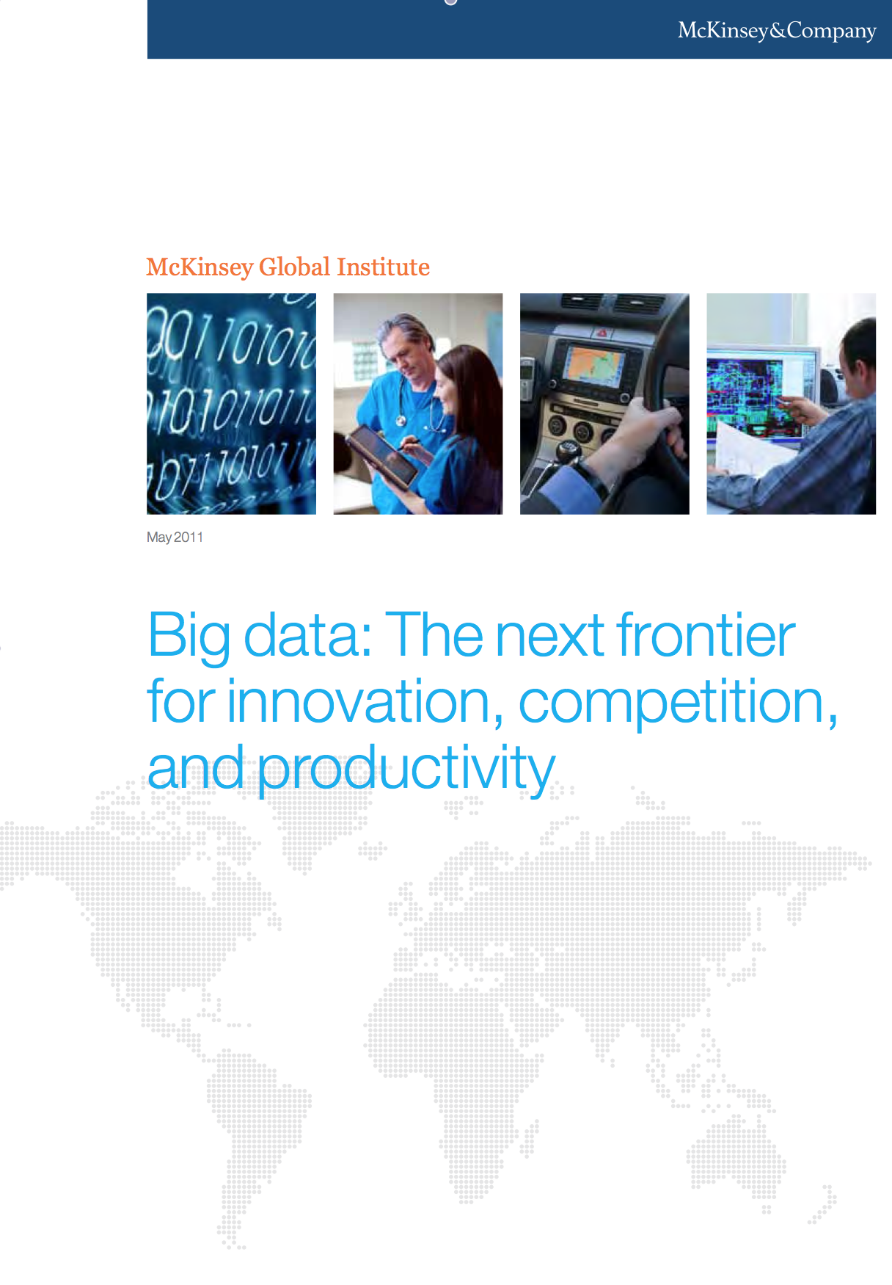
Why is this important now?
Up to a million additional analysts will be needed to address data analytics needs in 2018 in the US alone.
--- McKinsey Big Data Report, 2013-4
But right now, databases are rarely used for data analytics (or “data science”) by small-scale analysts
Most analysts use a combination of files + scripts + excel + python + R
Discussion Question: Why is that?

Slide 26
Why do databases fare poorly in “data science”?
Hard to use
Hard to learn
Does not scale
Not easy to do quick and dirty data analysis
Does not deal well with ill-formatted or noisy data
Does not deal well with unstructured data
Hard to keep versions and copies of data
Loading times are high
Cannot do machine learning or data analysis easily

Slide 27
Themes of the Course: Fixing these issues!!
Dealing with Unstructured Data:
Crowd Powered Systems / Algorithms
Dealing with Noisy Data:
Data Cleaning tools
Dealing with Huge Data:
Scalable Analytics Tools
Approximations
Dealing with Novice Analysts:
New Data Analytics Interfaces
Dealing with New Data Analytics Cases:
Machine Learning/Graph Systems

Slide 28
What is this course not about?
Distributed or parallel data management
But we will cover it peripherally
Cloud computing
Transaction processing, recoverability, …
Deep discussion of HCI aspects
But we will cover it peripherally

Slide 29
Part 1: Dealing with Unstructured Data
Images, Videos and Raw Text (80% of all data!!!)
Machine Learning Algorithms are not yet powerful
E.g., content moderation, training data generation, spam detection, search relevance, …
So, we need to use humans, or crowds to generate training data

Slide 30
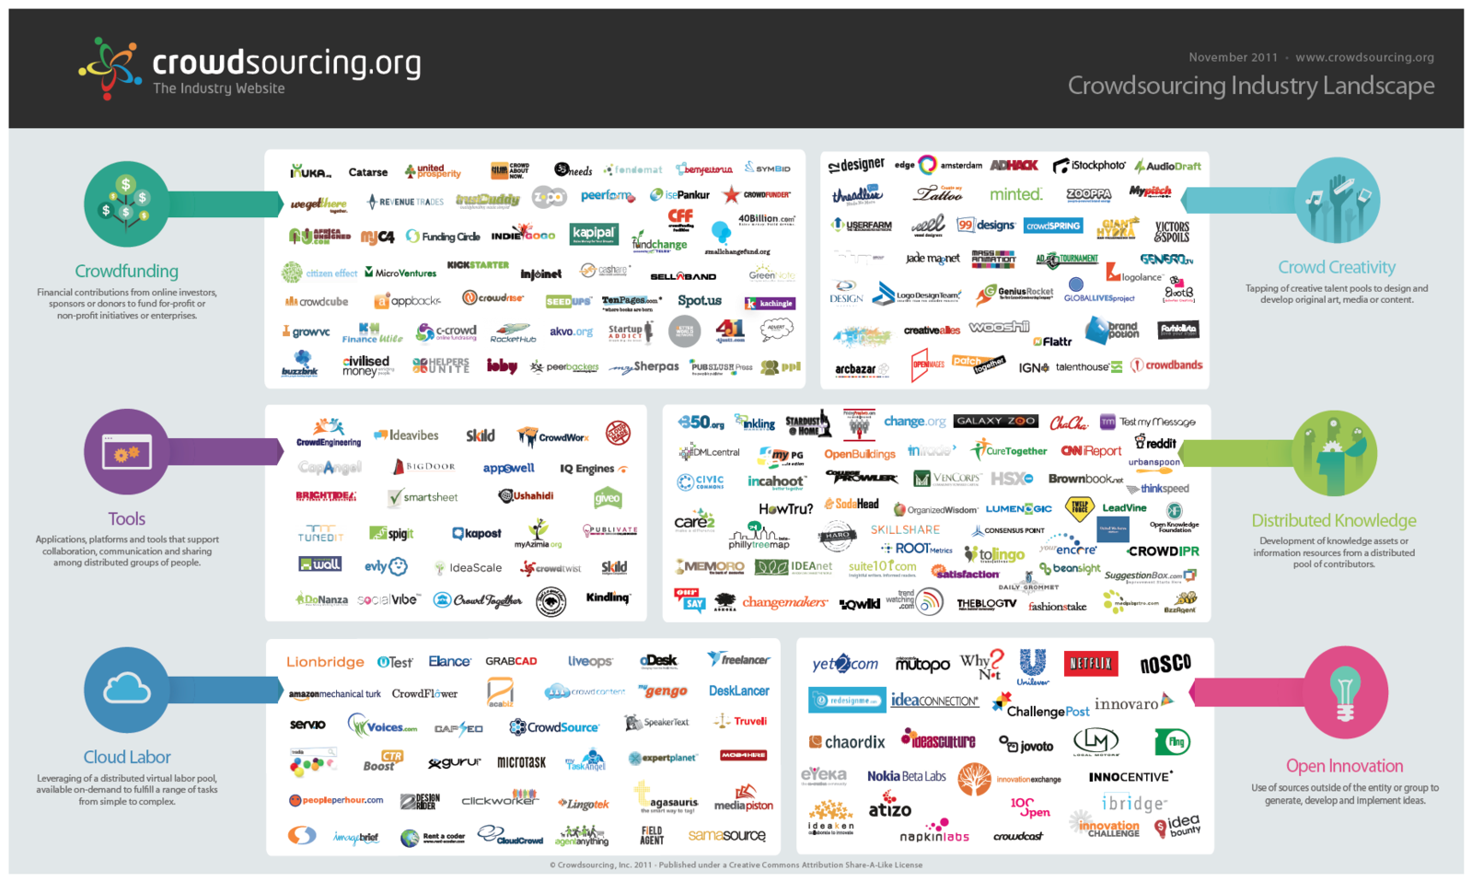
Crowdsourcing

Slide 31

Crowd “Marketplaces”
Can instead get
Comparisons
Pick odd man out
Rate
Pick best out of
Rank
Requester: Aditya Reward: 5¢ Time: 1 day
Is this an image of a student studying?
Is this an image of a student studying?
Yes
No
Notes:
To access crowd labor or paid crowdsourcing, we use marketplaces: each of these icons represents a marketplace
Marketplaces allow users to post tasks via low level apis, people who are online can pick up and solve the tasks
These marketplaces are growing FAST: total size quadrupled in 10 and 11, while the total revenue reached
example of a task I could post to a cr. Marketplace like mechanical turk. I post task, ppl online can solve and get 5c reward

Slide 32
Example
I want to sort 1000 photos using humans
How would I do it?
One strategy: ask one human to sort all 1000
Why bad?
What else can we do?

Slide 33
Why is using humans to process data problematic?
Humans cost money
Humans take time
Humans make mistakes
Also, other issues
We don’t know what tasks humans are good at
We don’t know how they are trying to game the system
We don’t know whether they are distracted
We don’t know whether the task is hard or whether they are poor workers

Slide 34
Part 2: Dealing with Noisy Data
Extracting structure from noisy and semi-structured data can be very hard to do without human help
We will study tools to let us extract value from noisy data (or even excel spreadsheets, webpages) easily

Slide 35
Part 3: Dealing with Huge Data
How can we get results quickly??
First main technique: Use approximations
Two ways of using approximations
Use “precomputed” samples, sketches or histograms

Slide 36
Part 3: Dealing with Huge Data (Contd.)
First main technique: Use approximations
Two ways of using approximations
Use “precomputed” samples, sketches or histograms
Do “online” query processing and termination
Second main technique: Leverage main-memory analytics
Disk is very slow; memory is the new disk
Can we do all our processing in main memory?

Slide 37
Part 4: Dealing with Novice Analysts
Gestural Interfaces:

Slide 38
Part 4: Dealing with Novice Analysts
SQL Query Suggestion

Slide 39
Part 5: Dealing with New Use Cases
Machine learning

Slide 40
All about you
Introduce yourself; which department/program you’re in; and your goals from this course

Slide 41
Any other questions?

